Slide 1

Plant Disease Detection using Machine learning &Image Processing
PROJECT PHASE- 2
Department of Computer Science & Engineering
GROUP 12
MALATHI T (STC20CS035)
MUHAMMED NAYIF M NAVAB METHA (STC20CS038)
NOURIN S (STC20CS043)
PRINCE SAJUVIN (STC20CS044)
GUIDED BY
Mr JAISON MATHEW JOHN
Assistant Professor Department Of Computer Science
& Engineering

Slide 2
CONTENTS
Abstract
Introduction
Software Requirement Specification
Existing System
Proposed System
Output\
Conclusion
References
2

Slide 3
ABSTRACT
Plant diseases are a major threat to food security, but their early detection and
identification remain difficult due to the traditional methods followed by the farmers.
Also, knowledge about pest management and control of diseases are less in various under-
developed countries.
Using machine learning to train the large data sets available publicly gives us a clear way to detect the disease present in plants in a colossal scale.
This project proposes a system which can detect crop diseases. The proposed system intimates the agriculturist about the plant diseases so that everyone can take further actions.
Growth patterns of crops will be fed into a convolutional neural network[CNN] to train the system.
3

Slide 4
INTRODUCTION
Plant disease detection involves the identification and diagnosis of
various diseases that affect the health and productivity of plants.
Early detection is crucial to prevent widespread crop damage, economic losses, and food shortages.
Technological advancements have revolutionized the field of plant disease detection.
The systems equipped with machine learning algorithms and image processing techniques can swiftly analyze large datasets of plant images and accurately identify symptoms of diseases.
4

Slide 5
SOFTWARE REQUIREMENTS SPECIFICATION
Software :
FrontEnd : HTML , CSS , JavaScript BackEnd : Python
IDE : VSCode
Hardware :
CPU : Intel core 3 Quad CPU RAM : 4 GB or above
Storage : 10 GB or above
5

Slide 6
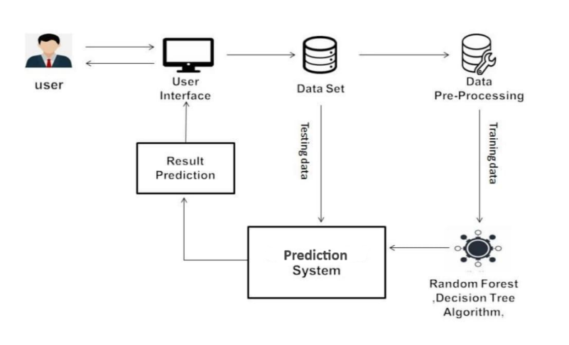
EXISTING SYSTEM

Slide 7
EXISTING SYSTEM
In this raw crop data is cleaned and augmented with metadata, facilitating easy training by converting relevant attributes to integers.
Then the metadata is integrated into the dataset, replacing converted values, and irrelevant data is filtered out.
Then this dataset is then divided into training and testing data.
After that build the model using Random Forest maching learing algorithm

Slide 8
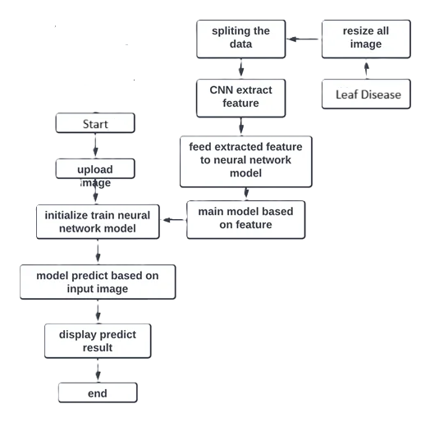
PROPOSED SYSTEM

Slide 9
PROPOSED SYSTEM
This proposed system aims to employ ResNet algorithm for automating computer-based diagnostics of plant diseases to mitigate agricultural risks.
It addresses the various symptoms and appearances of plant diseases poses a significant challenge.
In ResNet-based approach utilizing deep convolutional neural networks (CNNs) is adopted for diagnosing plant diseases.
The uploaded images of affected plants undergo ResNet-based analysis for feature extraction and disease classification.

Slide 10
PROPOSED SYSTEM
It involves preprocessing, training, and evaluation of the ResNet model for accurate disease classification.
This system enables early detection ,intervention, optimizing resource utilization and minimizing time and cost for users in agricultural field.
The system predicts the presence of a plant disease and recommends appropriate treatment based on disease detected.

Slide 11
Advantages of CNN
It is a deep learning architecture, specifically a type of convolutional neural network (CNN), designed to learn hierarchical features directly from raw data (e.g., images).
ResNet-based algorithms, especially in the domain of image processing, often outperform traditional methods due to their ability to capture complex patterns and details in images.
Deep learning models, including ResNet, require more computational resources and data to train effectively but can achieve progressive performance in complex tasks.

Slide 12
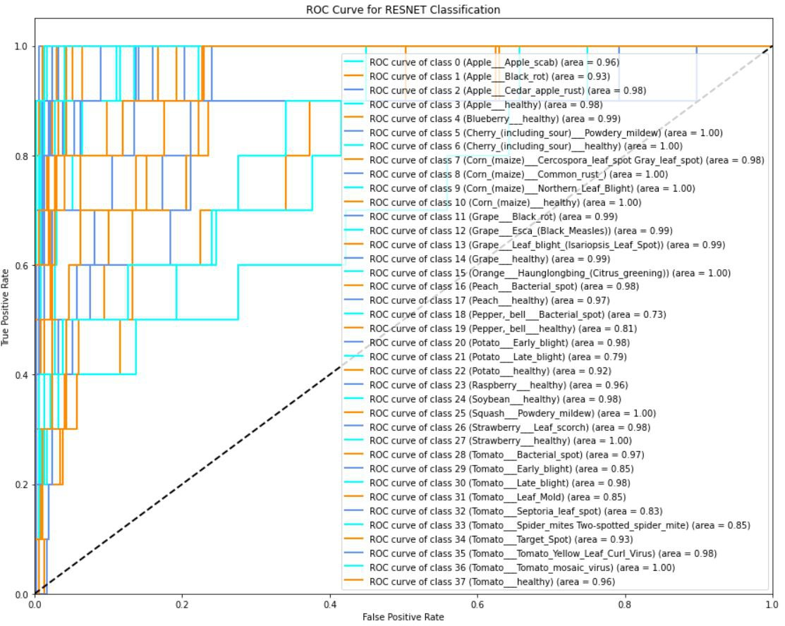
ROC CURVE

Slide 13
An ROC curve (receiver operating characteristic curve) is a graph showing the performance of a classification model at all classification thresholds. This curve plots two parameters: True Positive Rate False Positive Rate True Positive Rate (TPR) is a synonym for recall and is therefore defined as follows: TPR= TP TP+FN FPR= FP FP+TN

Slide 14
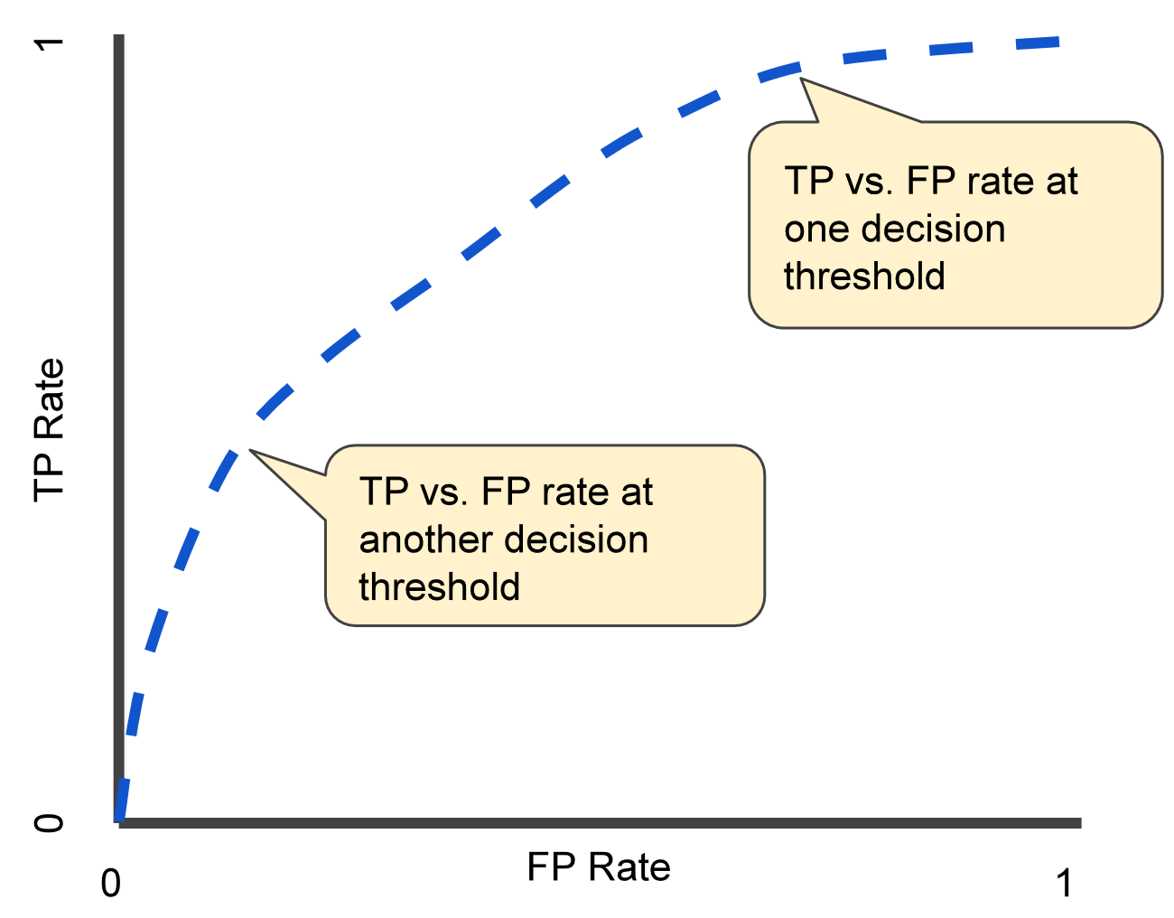
An ROC curve plots TPR vs. FPR at different classification thresholds. Lowering the classification threshold classifies more items as positive, thus increasing both False Positives and True Positives. The following figure shows a typical ROC curve.
To compute the points in an ROC curve, we could evaluate a logistic regression model many times with different classification thresholds, but this would be inefficient. Fortunately, there's an efficient, sorting-based algorithm that can provide this information for us, called AUC.

Slide 15
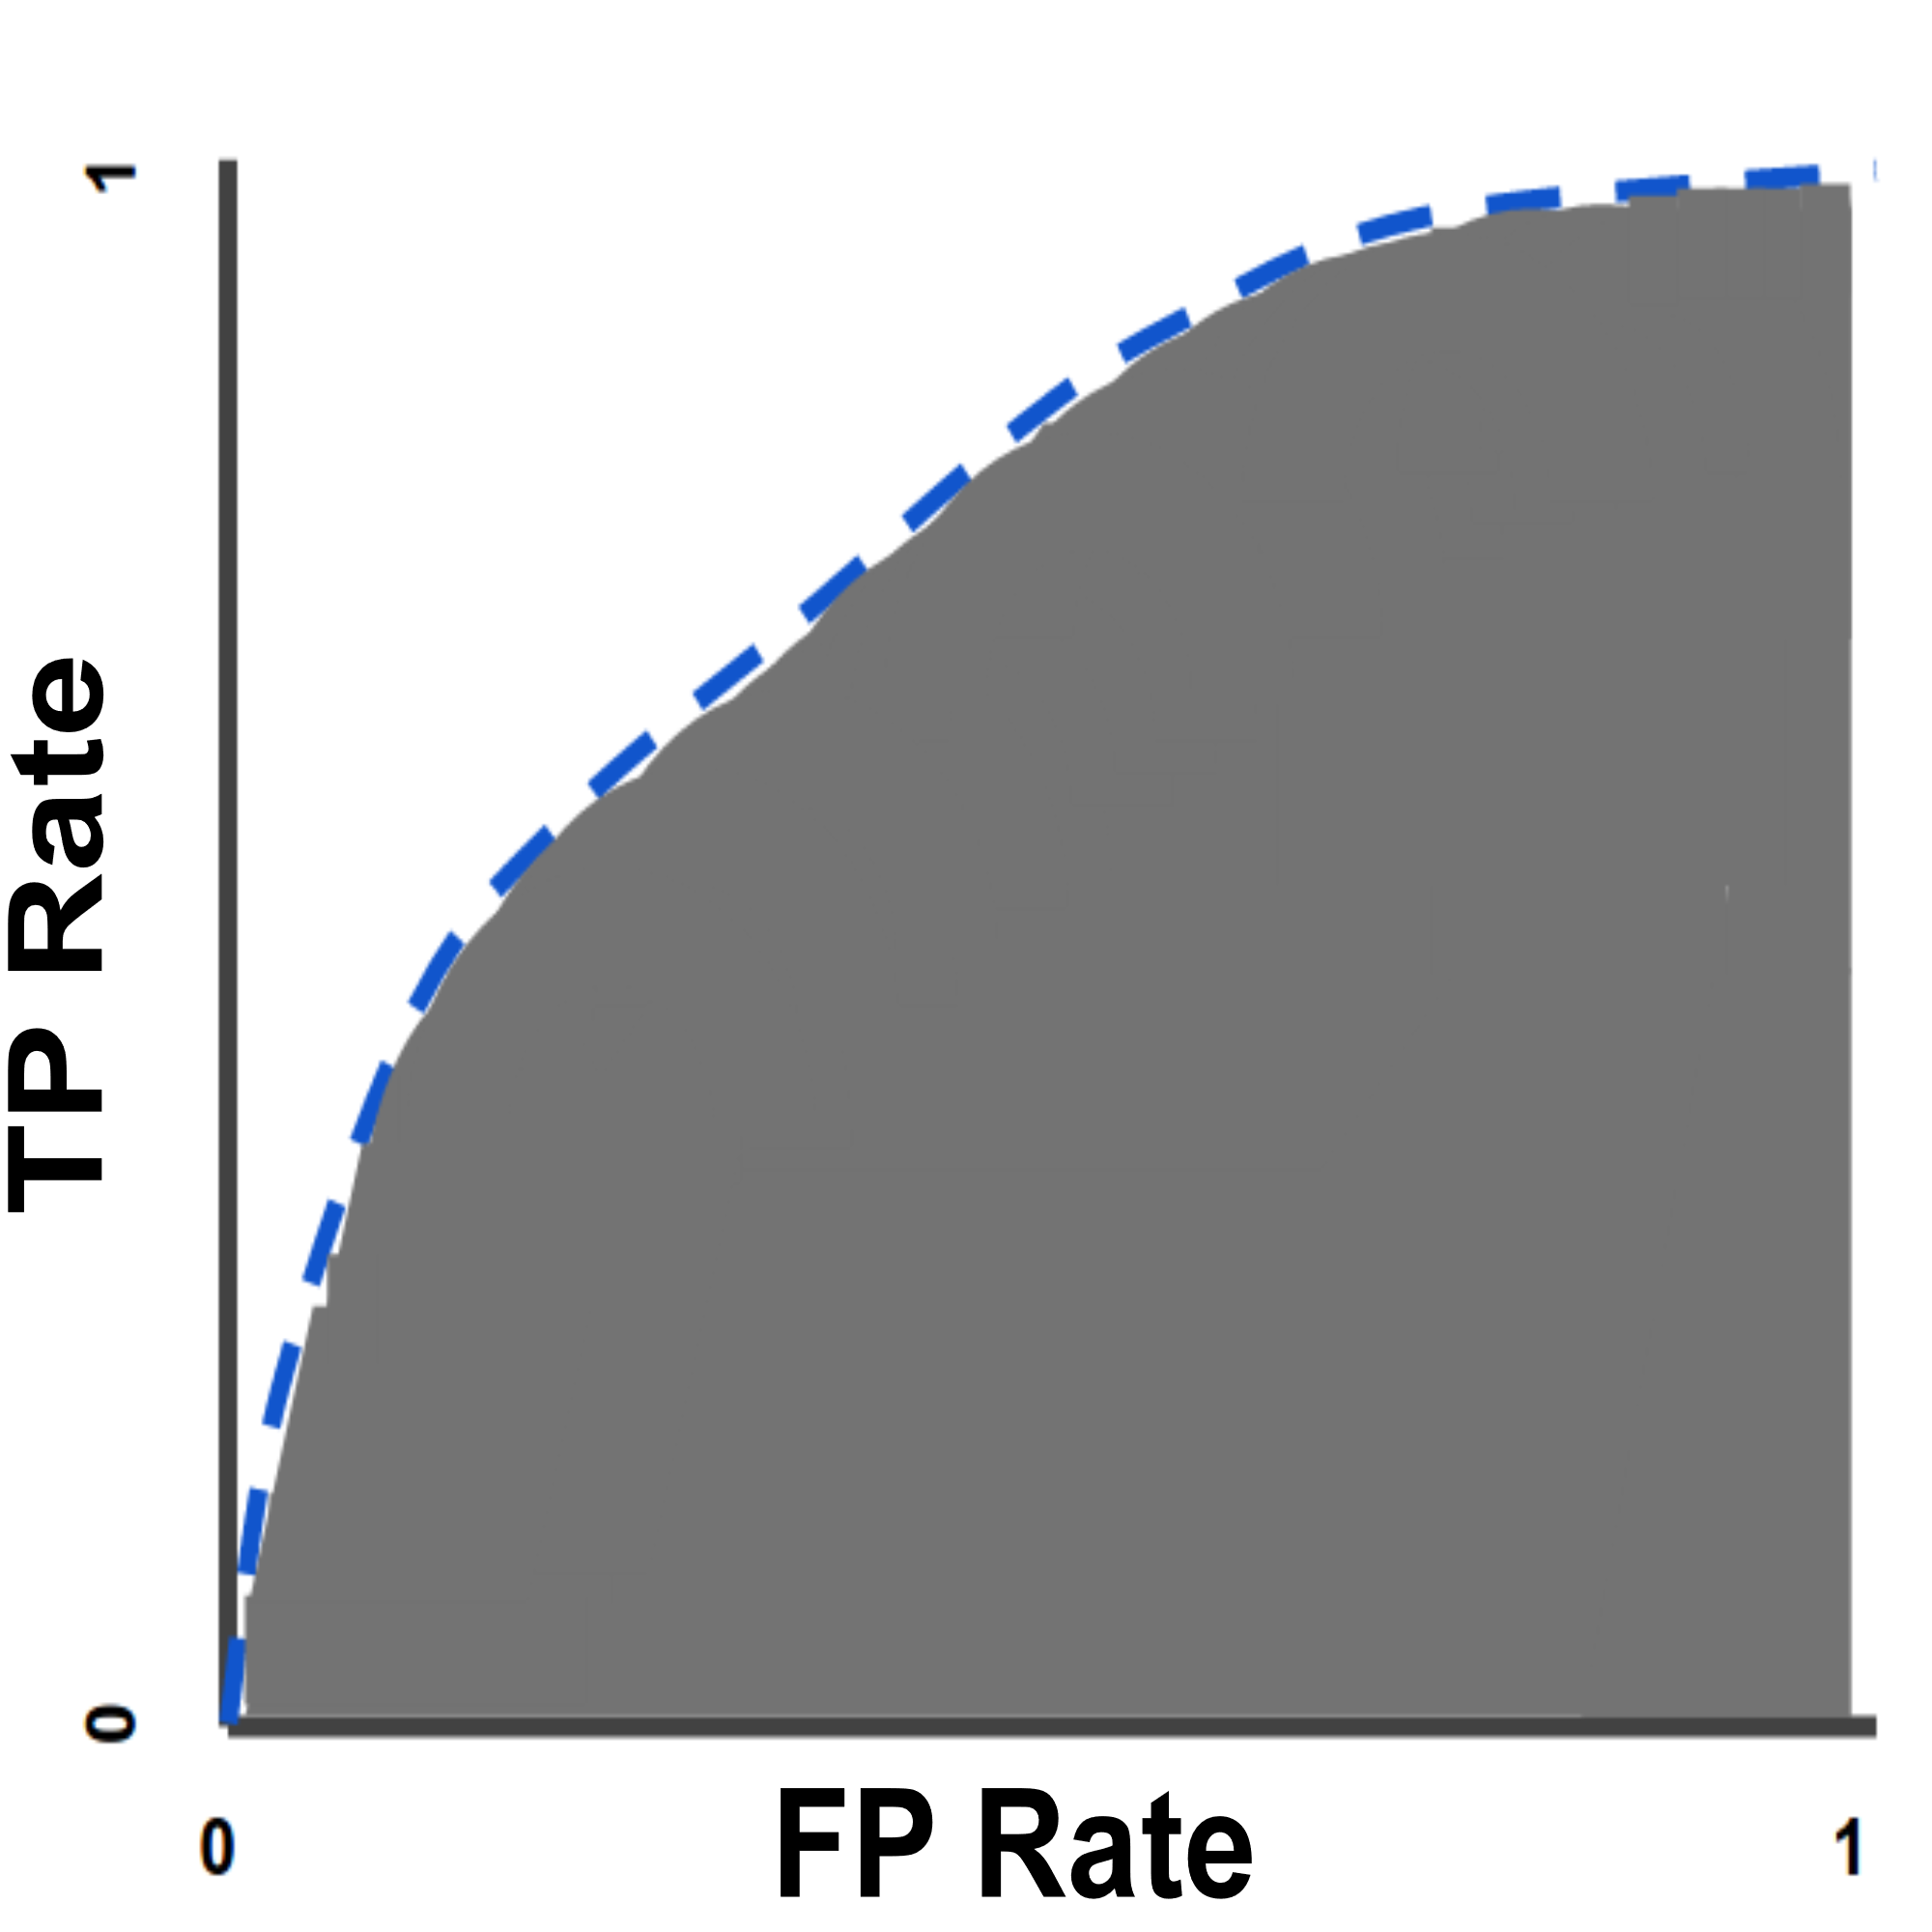
AUC stands for "Area under the ROC Curve." That is, AUC measures the entire two-dimensional area underneath the entire ROC curve (think integral calculus) from (0,0) to (1,1).
AUC (Area under the ROC Curve).
AUC provides an aggregate measure of performance across all possible classification thresholds.

Slide 16
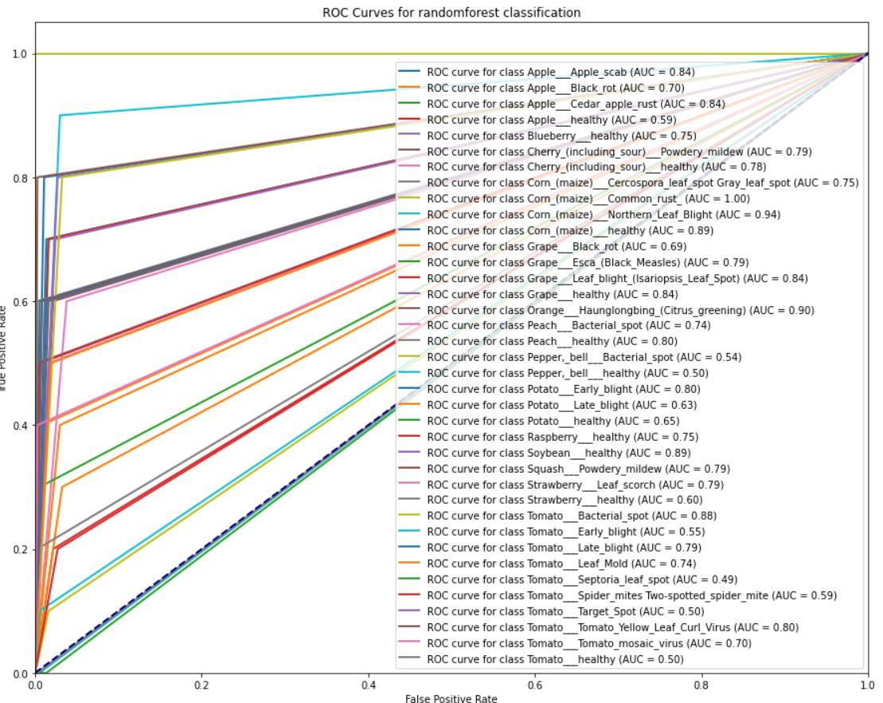

Slide 17
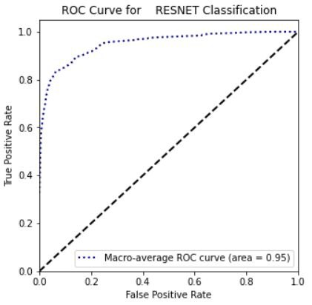
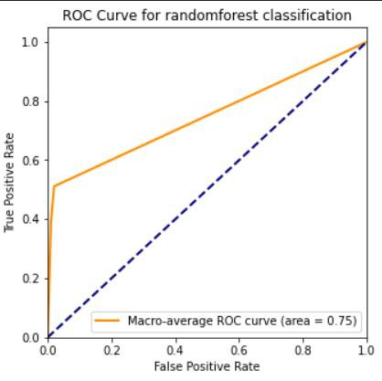










Difference

Slide 18

Output

Slide 19
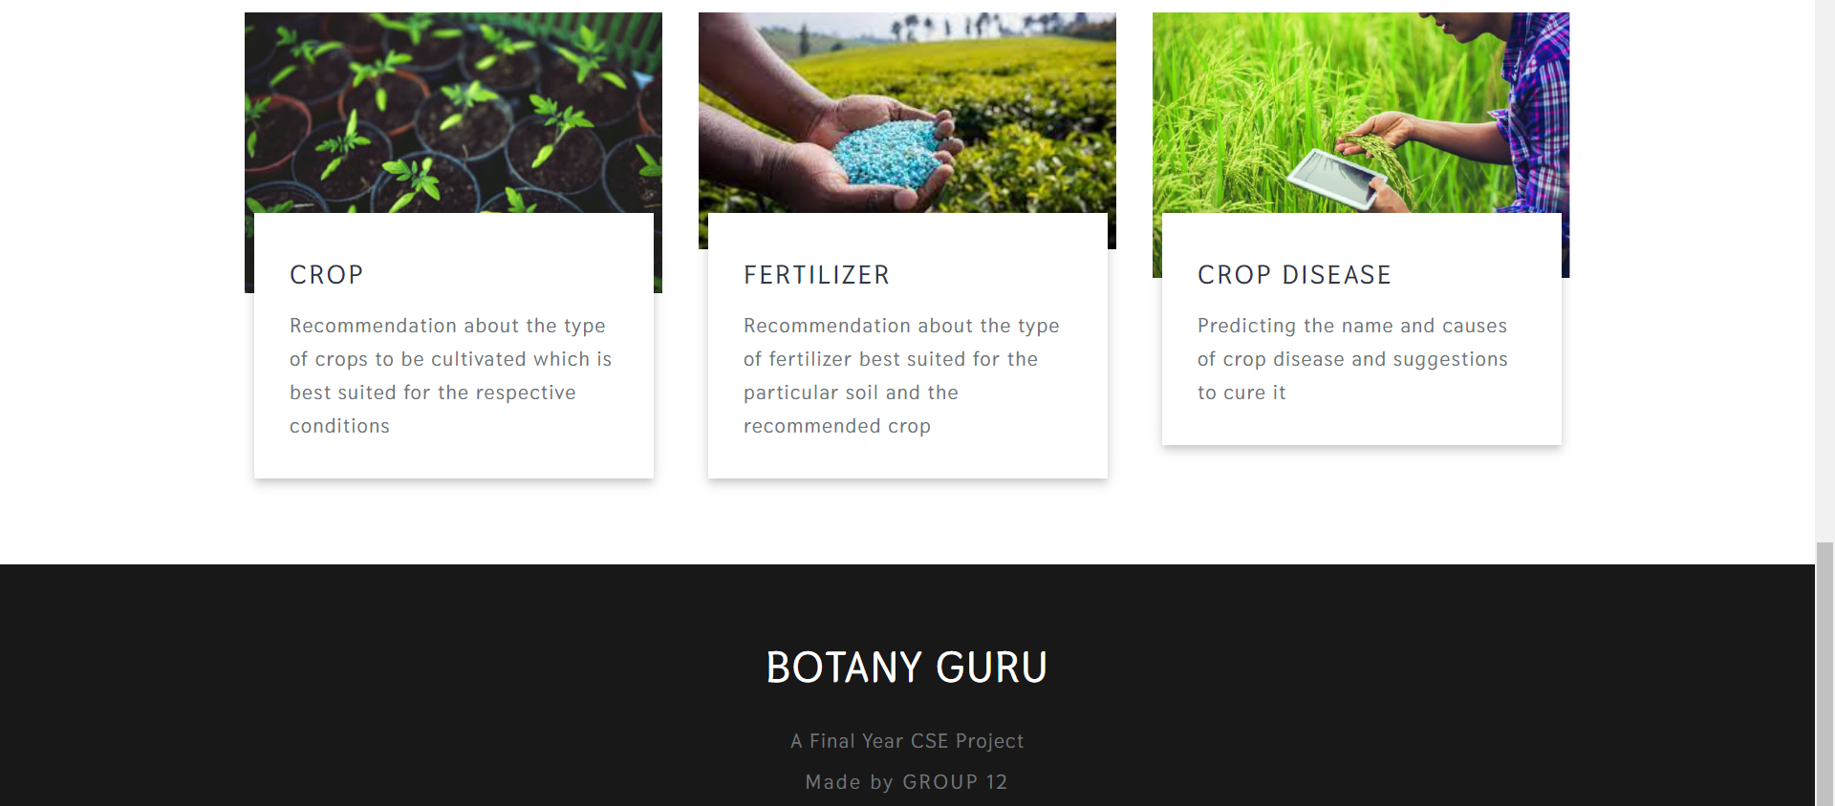
Output

Slide 20
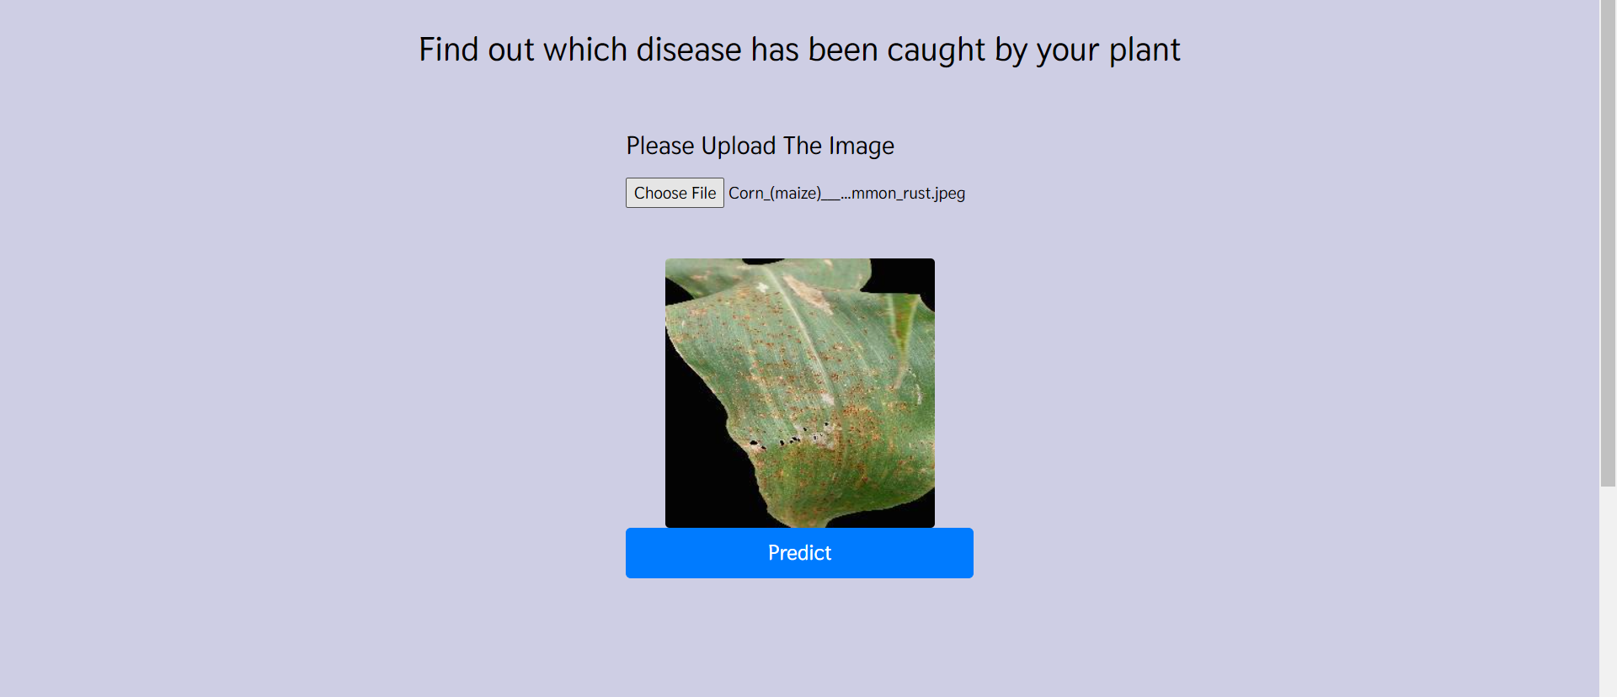
Output

Slide 21
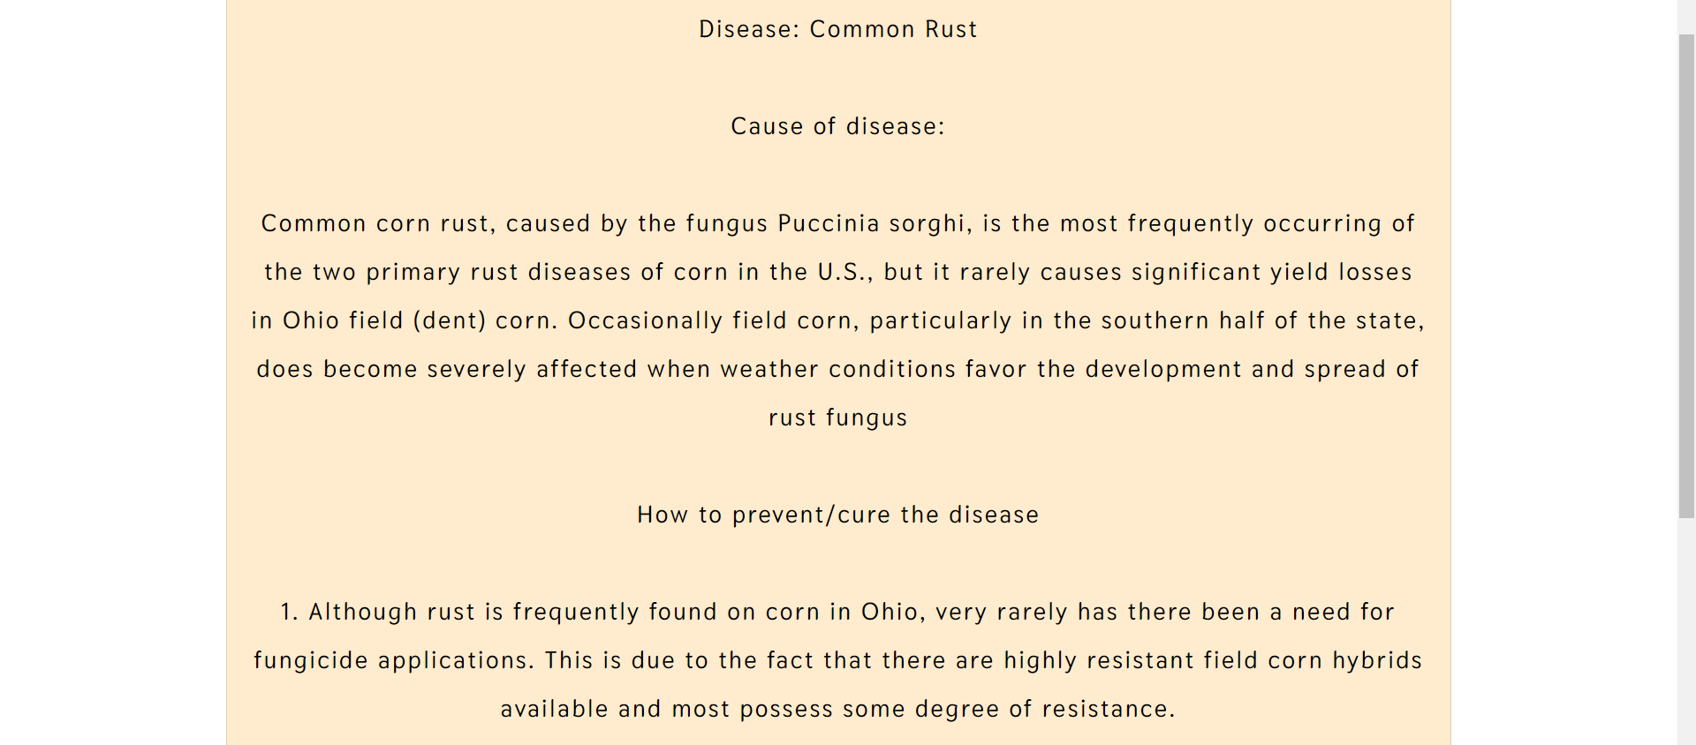
Output

Slide 22
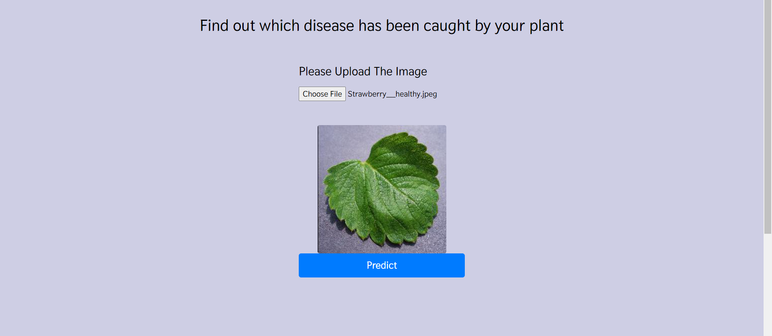
Output

Slide 23
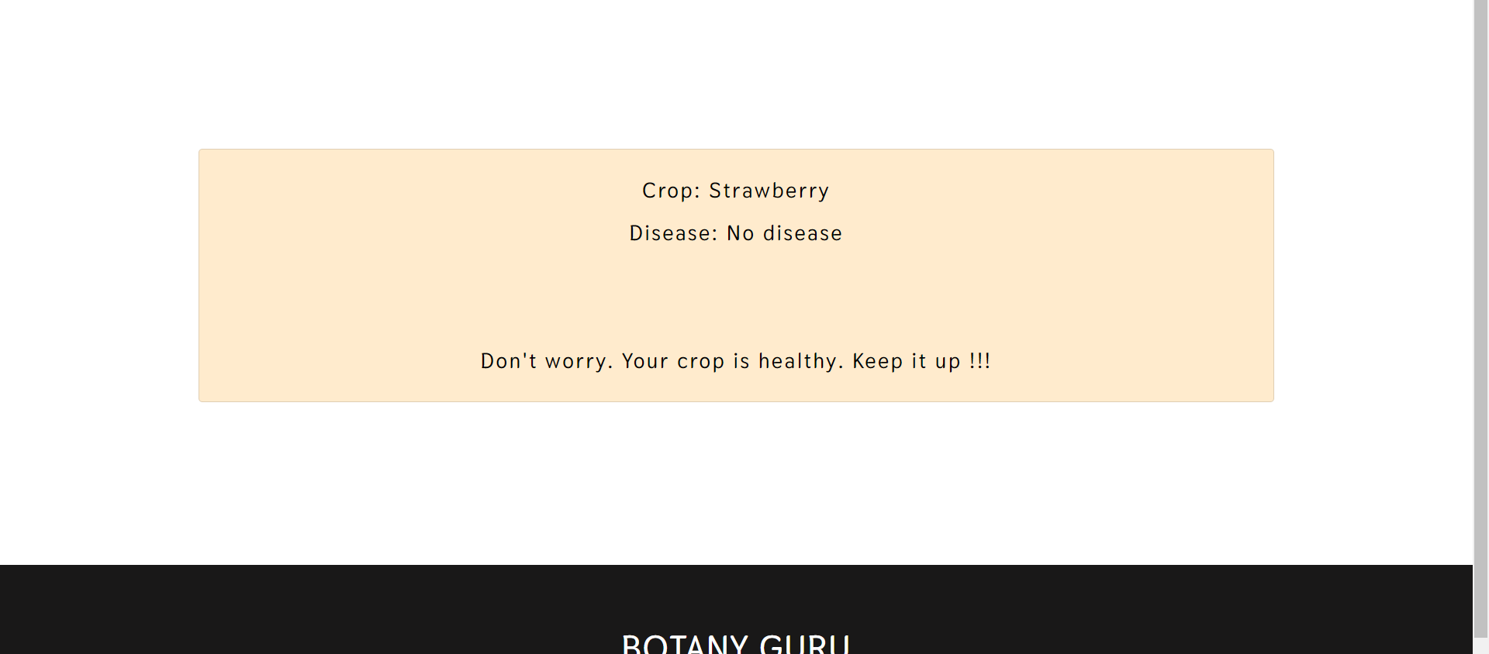
Output

Slide 24
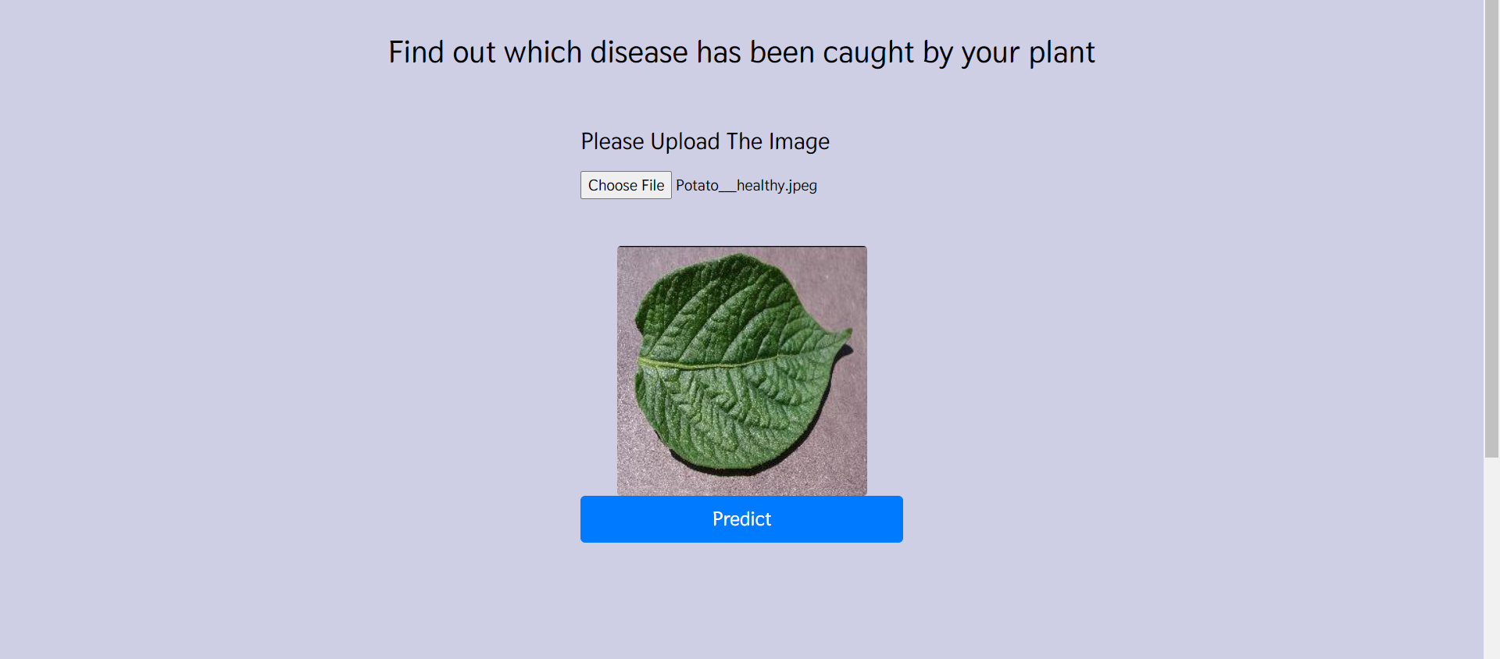
Output

Slide 25
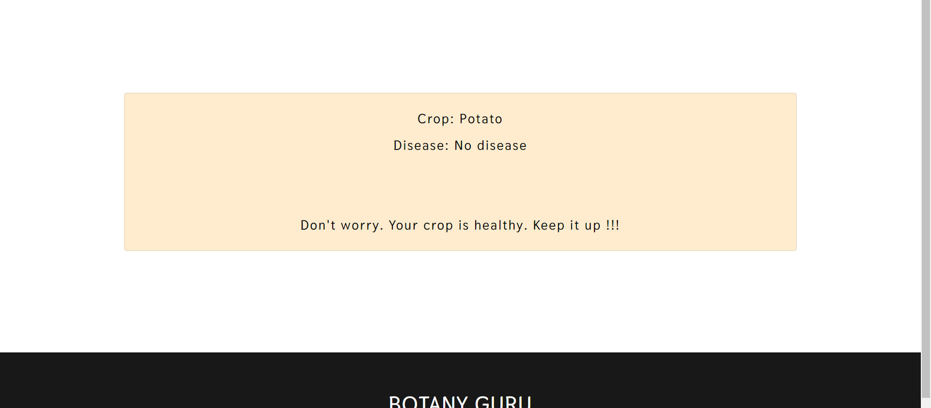
Output

Slide 26
PROPOSED FEATURES
Crop recomendation system based on soil content present and the weather parameters based on the place.
Fertilizer recomendation system based on soil content present and crop that we plant.

Slide 27
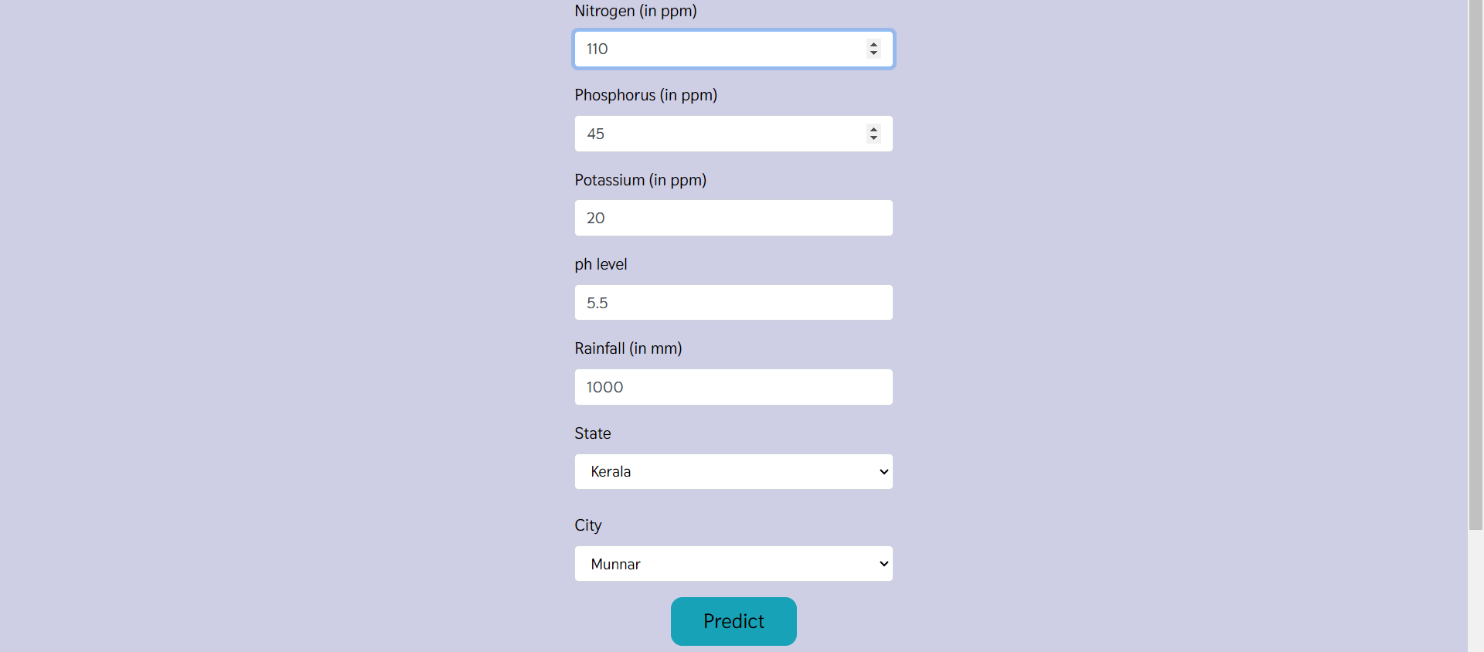
Output

Slide 28
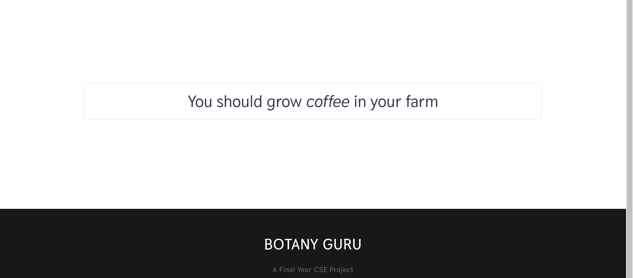
Output

Slide 29
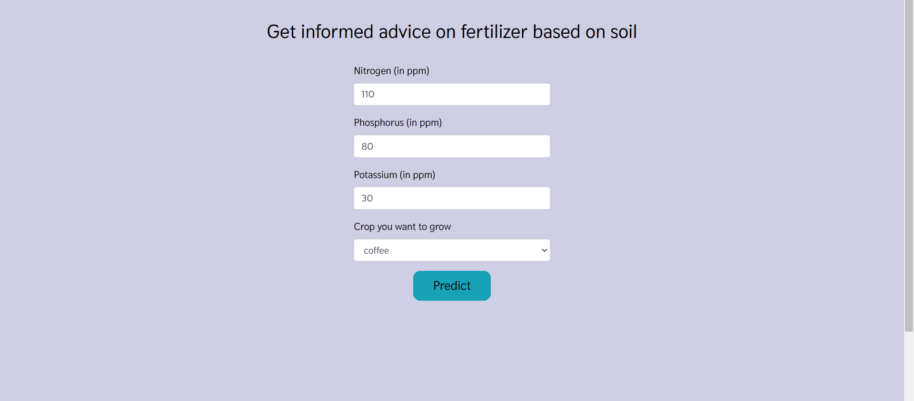
Output

Slide 30
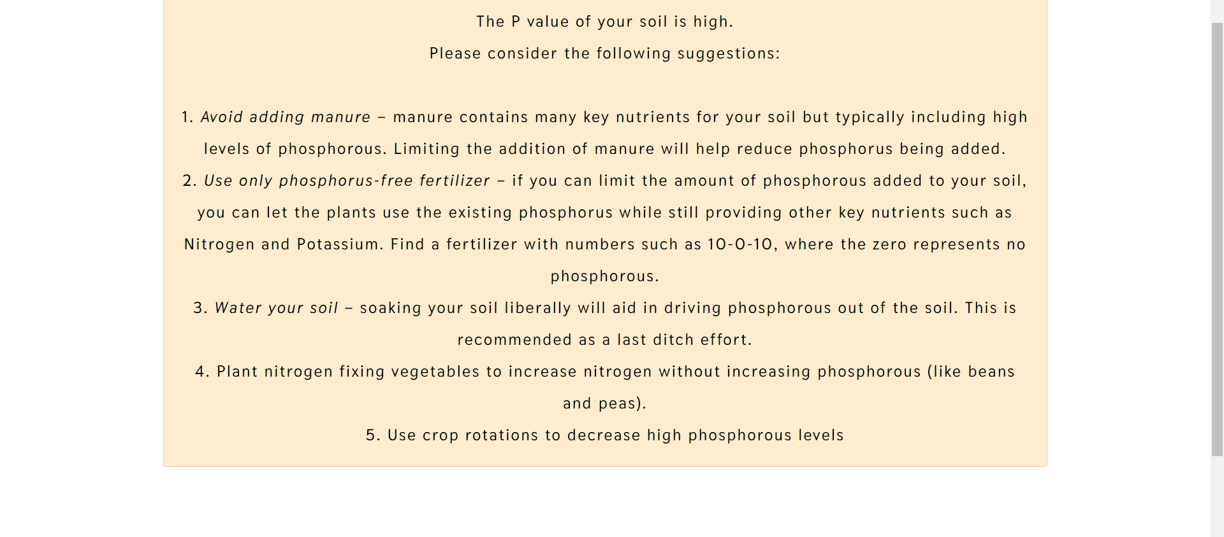
Output

Slide 31
CONCLUSION
The project on plant disease detection using machine learning demonstrates the potential for leveraging advanced technology to address critical agricultural challenges.
By harnessing the power of machine learning algorithms and image processing techniques, the project successfully highlights the feasibility of accurate and timely disease identification in plants.
The outcomes underscore the importance of integrating technological innovations with traditional agricultural practices to enhance crop management, minimize yield losses, and promote sustainable farming practices.

Slide 32
References
[1] A. A. Joshi and B. Jadhav, “Monitoring and controlling rice diseases using Image processing technique,” 2016 International Conference on Computing, Analytics and Security Trends (CAST), pp. 471–476, 2016.
[2] R. P. Narmadha and G. Arulvadivu, “Detection And Measurement of Paddy Leaf Disease Symptoms using Image Processing,” 2017 International Conference on Computer Communication and Informatics (ICCCI), pp. 1–4, 2017.
[3] R. Deshmukh and M. Deshmukh, “Detection of paddy leaf diseases, ” International Journal of Computer Applications, vol. 975, pp. 8887, 2015.
[4] S. Phadikar and J. Sil, “Rice Disease Identification using Pattern Recog- nition Techniques, ” 2008 11th International Conference on Computer and Information Technology, pp. 420–423, 2008.
[5] G. Anthonys and N. Wickramarachch, “An Image Recognition System for Crop Disease Identification of Paddy fields in Sri Lanka,” 2009 International Conference on Industrial and Information Systems (ICIIS), pp. 403–407, 2009.

Slide 33
THANK YOU

